Slide 1
CE/CZ 3001 Lab 3

Slide 2
Objectives
Implementation and functional verification of three-stage pipeline architecture for R-type instructions.
Design, Implementation and functional verification of three-stage pipeline architecture for R&I-type instructions.
Design, Implementation and functional verification of four-stage pipeline architecture for R&I-type instructions.

Slide 3
Points to be noted (R type- three –stage pipeline)
Program counter available in ‘PC.v’
Instruction memory available in ‘memory.v’. The ‘memory.v’ can be utilized as Instruction or data by changing the respective fields. Currently it is set as instruction memory. You need data memory only for LW/SW instructions. The ‘memory.v’ uses file operation and the instructions are accessed from a file.
(Note that memory is clocked and hence we have a clock cycle delay for getting the output from memory.)
Datapath modules discussed in lab 3 are available at ‘Alu.v’, ‘control.v’ and ‘regfile.v’. Here we are not using initialization muxes. In order to initialize ‘ regfile.v’, we have assigned a value inside ‘regfile.v’ itself.
The ID/ EXE register is available in ‘ID/EXEsatge.v’. Please note that you need to pass your write address to the pipeline register as write address should come at the same time of write data.

Slide 4
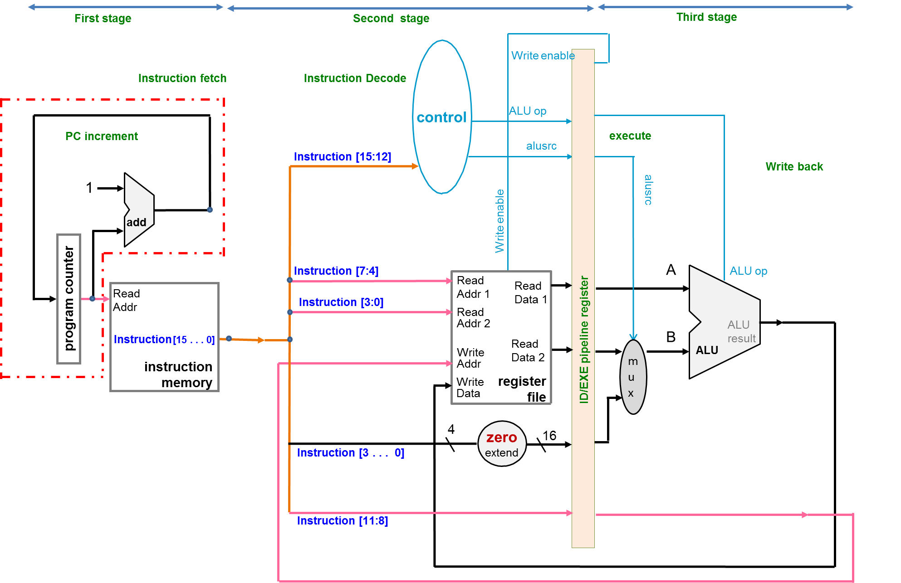
Control signals for ALU op,
alusrc and write enable
=1
read address 1
rdata1
rdata1
aluout
read address 2
rdata2
waddr
Clock cycle 1
First instruction in first stage
(fetch)
wdata
Clock cycle 2
First instruction in second stage
(decode)
rdata2
Clock cycle 3
First instruction in third stage
(execute writeback)
Second instruction in second stage
(decode) (animation not shown)
waddr
Here the waddr is coming at the same clock cycle (3rd cycle) as wdata to the regfile.
If waddr came early (2nd cycle) to regfile then the data will be written to a different location.
Hence we need to pipeline the waddr.

Slide 5

Please note that the ‘write enable’ is not taken to the pipeline (ID/EXE) in the given code basically because for all your instructions (R & I type) ‘write enable =1’. Hence that was made as a constant for easier programming. But if you have instruction like store and branch where you don’t want data to be written to a ‘regfile’ you may have to take ‘write enable’ signal as a variable and need to take it through pipeline.

Slide 6
Points to be noted (R&I three stage implementation)
For R –type instuctions we need only to read the register file, the ‘imm’ input was not considered and hence we did only a zero extension for the same.
For R& I, We need to sign extend ‘inst[3:0]’ to 16 bits
Sign extend

Slide 7
For testing (R& I three-stage pipeline) using test bench.
You can write a testbench similar to the testbench of R-type instruction. Include SLL and SRL instruction in IMEM input file to test its functionality.
You may notice that you will get the results after a clock cycle delay.
Understand the functionality with the help of testbench.
Synthesize the code and find the area (registers and slice LUTs) and minimum period.

Slide 8
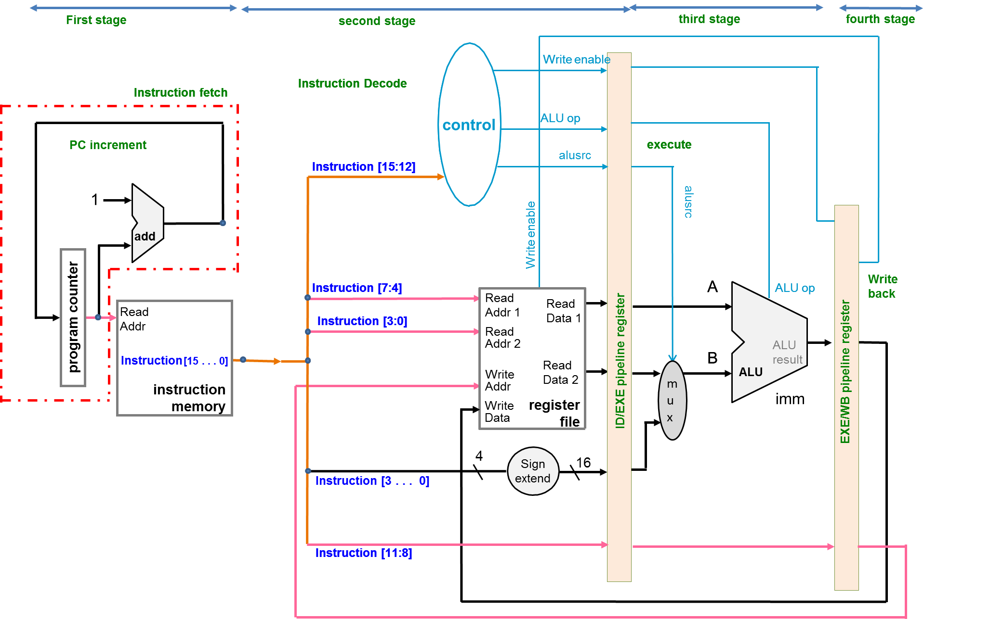
4-stage pipelined architecture for R&I instructions
Control signals for ALU op and write enable
Clock cycle 1
first instruction in first stage
(fetch)
=1
read address 1
rdata1
rdata1
read address 2
rdata2
Clock cycle 2
First instruction in second stage
(decode)
Second instruction in first stage
(fetch) (animation not shown)
waddr
wdata
rdata2
Imm for SLL and SRL
Clock cycle 3
First instruction in third stage
(execute)
Second instruction in second stage and
third instruction in first stage
(animation not shown)
waddr
waddr
Clock cycle 4
First instruction in fourth stage
(writeback)
Hence 4 clock cycles to execute. Each stage takes one clock cycle.

